Slide 1
International trends in the Bioeconomy
Lene Lange
Professor, PhD et Dr. scient.
Technical University of Denmark, DTU
Member of the EU BBI, Scientific Committee
Coordinator, Nordic Council of Ministries Bioreffinery project
Member of the Danish Bioeconomy Panel
Chairman, IAB, BIOTEC, Bangkok, Thailand
Member, BIONÆR, Norwegian Bioeconomy Research Council

Slide 2
EU Horizon 2020 Vision
The Bioeconomy deliver on all three parts of the Horizon 2020 Vision: a smart, sustainable and inclusive society!
It will benefit
the environment by improved use of natural resources
existing industry and new start-up business
social inclusiveness, creating jobs also in rural areas

Slide 3
The new Bioeconomy, Trend 1 -Bioeconomy is much more than bioenergy
The new Bioeconomy builds on:
Many types of biorefineries
Many types of biomass
Many types of processes
Many types of value added products

Slide 4
Bioeconomy includes many types of Biorefineries -big and small
The Yellow Biorefinery (straw, corn stover, wood)
The Green Biorefinery (fresh green biomass; grass for protein-rich animal feed!)
The Blue Biorefinery (fish by-catch/side-streams; brown, red and green algae; sea cucumber)
The Grey Biorefinery (agroindustry byproducts)
The Brown Biorefinery (sludge & household waste)
Big Biorefineries, efficient conversion, low profit margin, bulk products
Small Biorefineries, high value products, food, feed and pharma

Slide 5
The new Bioeconomy, Trend 2 -Focus on higher value products
Unlocking the full potentials of the biomass
Following the value cascading principle
Give high priority to Food and Feed ingredients, high value materials and chemicals and transport fuel; nutraceuticals and health products
Only using left over of the biomass for downgrading to energy, biogas, electricity and heat

Slide 6
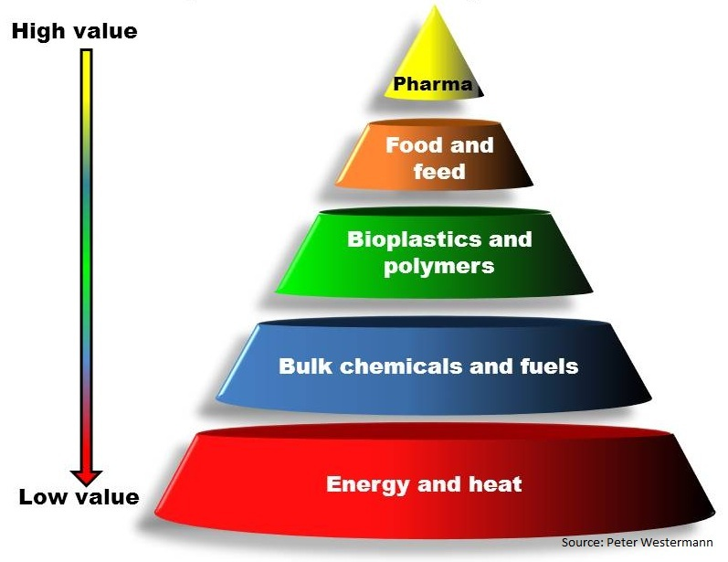

Slide 7
Trend 3: There is much more Biomass available
Exploit agroindustrial side streams, household waste and waste water sludge
Change cropping pattern
Growth year around, optimizing sunlight, water and soil
=>
Twice the yield with half the environmental impact
*) Source: Uffe Jørgensen, Aarhus University, Denmark

Slide 8
Trend 4, Making value from complexity -not just breaking down polymers to monomer sugars
Recover valuable molecules:
Proteins
Prebiotics from hemicellulose (C5 oligoes)
Aromatics
Lipids
Metabolites

Slide 9
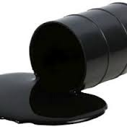
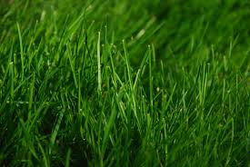
3
Grass
Plant cell wall structure:
OBS Biomass can be used for much more than you can make from crude oil. In biomass the complexity of the plant components is intact. In the oil, fossilation has degraded the complexity: No proteins; no long and branched polymers.
Proteins and Food ingredients

Slide 10
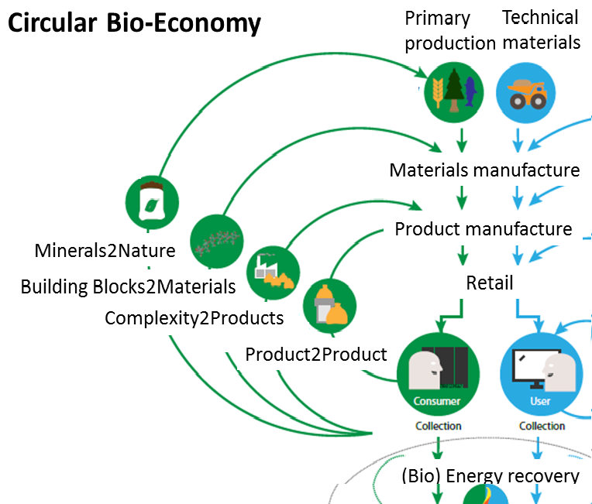

Slide 11
Efficient use of own protein resources -to substitute imported soy protein for animal feed
Goal: improved use of local protein resources
The green biorefinery, protein rich feed from grass/clover
Fish waste
Oil seed press cake

Slide 12
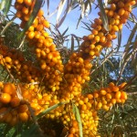
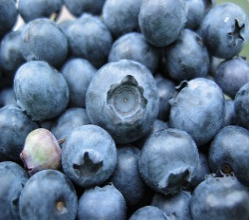
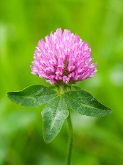
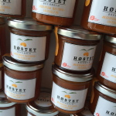
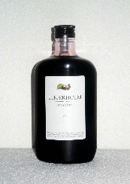
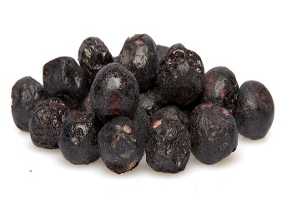
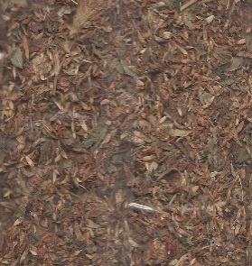
The Green Biorefinery, making value from complexity: Nutrition and health products from berries and vegetables
Active compounds
Sea-buckthorn
Aronia
Blueberry
Red clover
End-user products
Jam
Juice
Dried berries
Tee

Slide 13
Prebiotic feed and food ingredients
C5 oligoes give healthier gut flora:
For man: increased robustness towards life style diseases
For animals: improved welfare
healthy gut flora =>
less use of antibiotics
less problems with antibiotic resistence

Slide 14
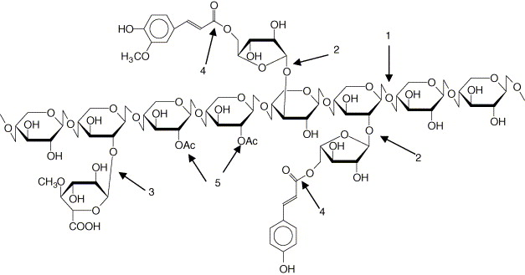
Hemicellulose, C5 polymer: modified enzymatically to C5-oligos for prebiotic food and feed ingredients (=> improved gut health)

Slide 15
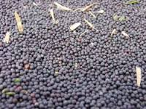
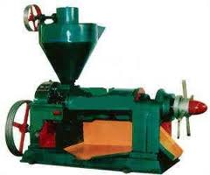
Rape seed press cake biorefinery: a new biomass for producing food and feed ingredients
Oil seed press cake
=>
Rape proteins and fibers
For healthy, prebiotic food and feed ingredients
=>
Animal feed: more healthy gut flora, less antibiotics
&
Functional peptides with human health properties

Slide 16
The new Bioeconomy, Trend 5: - new biorefinery from animal biomass

Slide 17
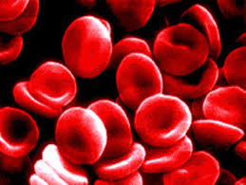
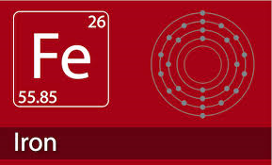
The modern slaughterhouse: -a new resource for upgrade to higher value products
Waste streams from meat and chicken production:
Blood => Iron rich food ingredient, nutraceutical or drug
Feather and Bristle => protein rich animal feed

Slide 18
Biorefinery diversity, Trend 6: The Blue Biorefinery is different and very promising!
So far focus in the bioeconomy has been on plant materials
Blue biomass conversion is very different from processing plant biomass:
Fish/animal: no cell walls!
Macroalgae: cell walls but different composition; and diversity of unique polymers!

Slide 19
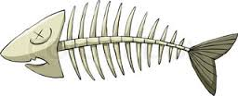
The Blue Biorefinery -from waste and by-catch to healthy feed and food ingredients
Volume: Fish waste and by catch is more than 50% of total catch!
Enzymatic conversion, hydrolysis of proteins =>
Healthy, proteinrich feed and food ingredients; value chains:
protein hydrolysate, functional healthy peptides, fish oil, Omega3; cosmetics; wound healing products.
Needs: discovery of new and improved enzymes and development of new processes. Much is already within reach!

Slide 20
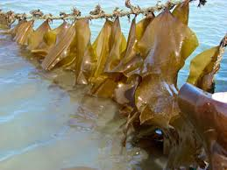
The Blue Biorefinery/Value Cascading!
11
Sea weeds / Macroalgae
Species: interesting potentials
of brown, red and green algae
Production: capture and cultivation;
environmental approvals needed!
Products:
Gourmet food!
Fucoidan; proteins; cosmetics, food and feed ingredients health
Functional polymers
Sugars for fermentation e.g. fuel
fertilizer -phosphate back to soil
Energy recovery economically viable only if part of value cascade

Slide 21
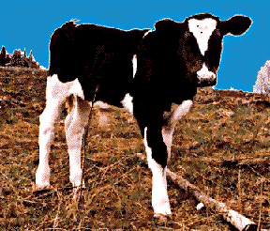
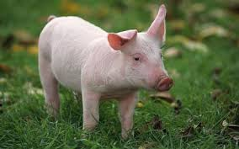
Trend: upgrade biomass to animal feed -free land to produce food or biodiversity
The cow has its own biorefinery!
The cow has its own rumen biorefinery!
Biorefinery of grass
and clover => protein rich animal feed for fish
Chicken and pigs
One stomach animals
needs bioaccessible
feed

Slide 22
Learning from nature, Trend 7

Slide 23
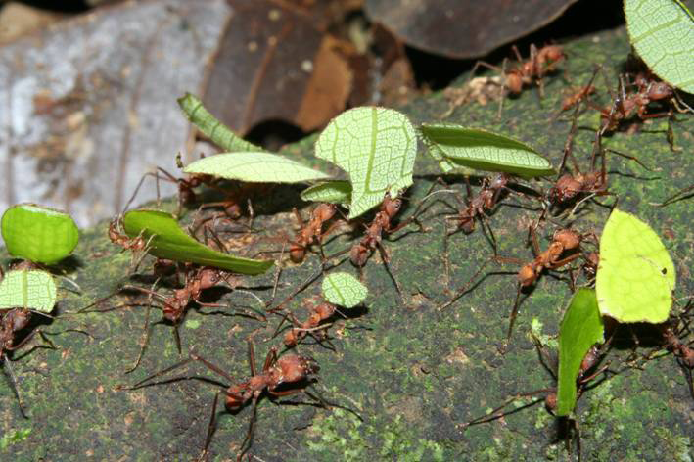
Leaf cutter ant’s fungal garden The ants eat not the leaves but the fungus!
B
The feed for the ant larvae comes from the fungus!
The fungus develops bunches of hyphal baloons, filled with protein and sugar! Picked by the ants as baby feed

Slide 24
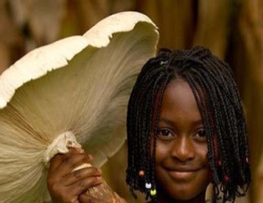
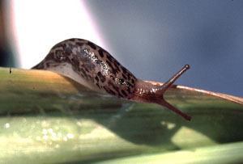
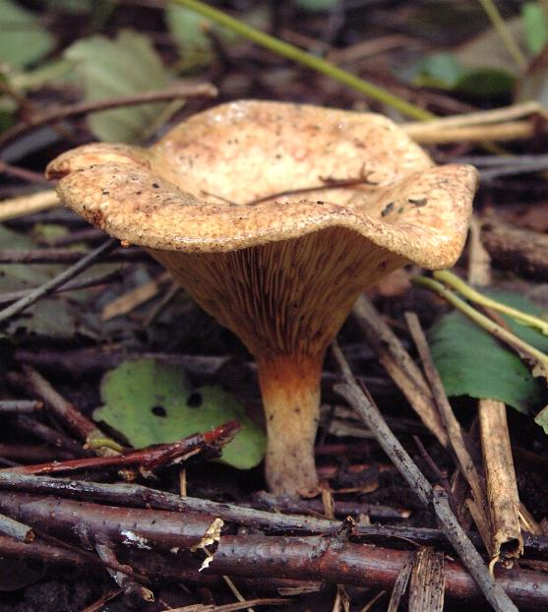
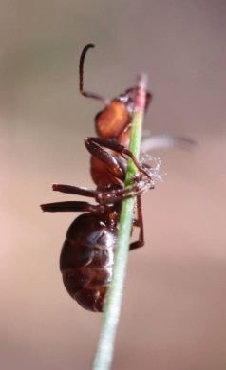
Making value by learning from Nature! Discovery from nature´s own biomass conversion!
Termite larvae (gut channel)
Termitomyces titanicus
Cow (rumen)
Iberian snail (gut)
Leaf cutter ant
Leucoagaricus gongylophorus
Ectomycorrhiza; Fungi on insects

Slide 25
Learning from Nature: Discovery for the blue biorefinery
Mining the microbial enzymes of
Star fish
Sea urchin
Snail
Crab
Cod
Salted fish, microbial consortium
by metagenomic, metatranscriptomic & secretome analysis by Peptide Pattern Recognition, predicting function directly from sequence (Refs, PPR: Busk & Lange 2012, 2013, 2014 & 2015)

Slide 26
The Waste upgrade biorefinery, Trend 8 ”Waste2Value”

Slide 27
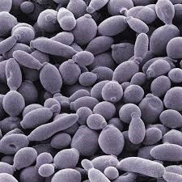
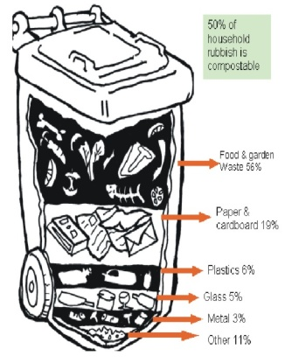
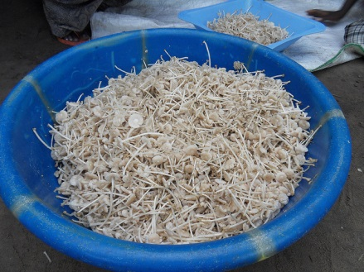
Vision: create value also from mixed and wet organic waste streams
Household waste can be a growth medium:
Biotransforming waste to
Fungal or bacterial biomass
=>
Products:
Grow bactera for BioPlastic
-or
Fungi as protein-rich animal
feed
Result: saving land for growing food,
Feeding a growing population! New Business!
Yeast cream
Mushroom mycelium

Slide 28
Fungus grown by subterranean termites in Africa
Termitomyces titanicus up to 48% protein content

Slide 29
The new Bioeconomy Trend 9 -solving the ”food versus fuel” dilemma
You can harvest the full crop and use it as biorefinery feed stock (e.g. grass, clover or beet roots)
and
From the biorefinery process you can get as much animal feed as you got from the total grain harvest before, plus industrial products like chemicals or fuel, plus biogas

Slide 30
Bioeconomy Trend 10: Europe is still in lead -but also falling behind
Asia, China and India, US, Brazil –all are moving into making bioeconomy into a new line of business –primarily using European technologies!
Europe is still very advanced and active in building Bioeconomy-relevant knowledge and technologies
BUT: Europe can move much faster in using new knowledge for new business, creating Jobs, improved resource efficiency and competitiveness

Slide 31
The new Nordic Bioeconomy: Norway
Focus: higher value products; energy from residual only
The Blue Biorefinery
The Green Biorefinery
The Waste Biorefinery
and ”On board biorefinery” –processing by-catch
Strategy: find your role and find your partners!
Fast implementation, e.g. fish hydrolysate; fish feed
Be preferred partner for international technology experts
Nordic collaboration
ScanBalt collaboration
Collaborate to develop the Arctic Bioeconomy

Slide 32
Stop dreaming –start driving! Unfold the potentials of the Bioeconomy
Lene

