Slide 1
Gjenvinning av energi og næringsstoffer
ved biologisk konvertering
Pål Jahre Nilsen
CTO
6/30/2015
1

Slide 2
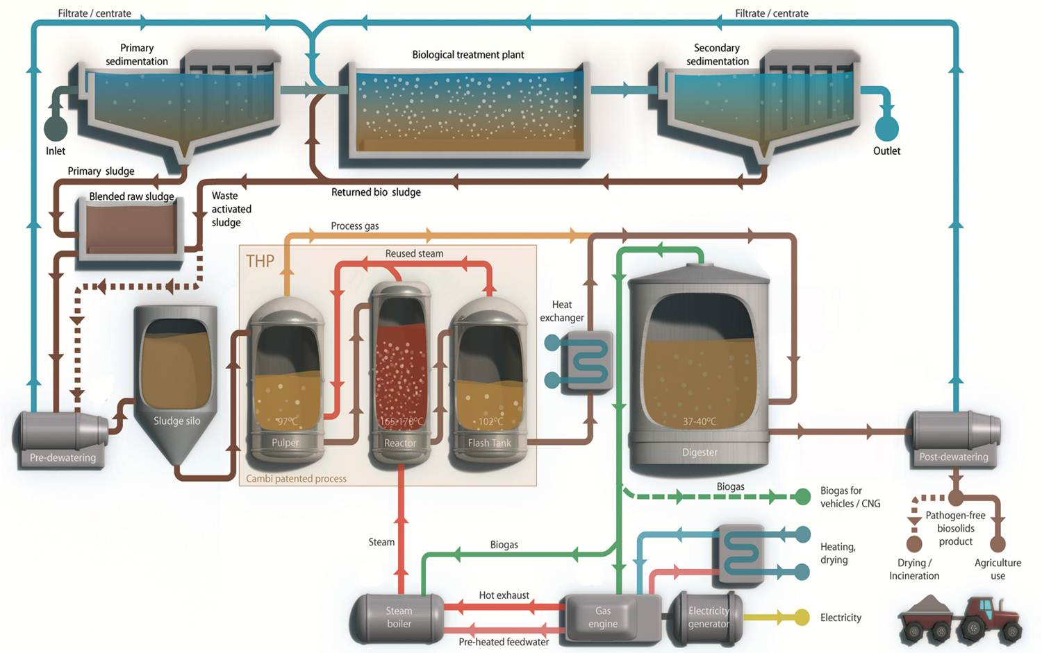
Cambi THP I ET RENSEANLEGG

Slide 3
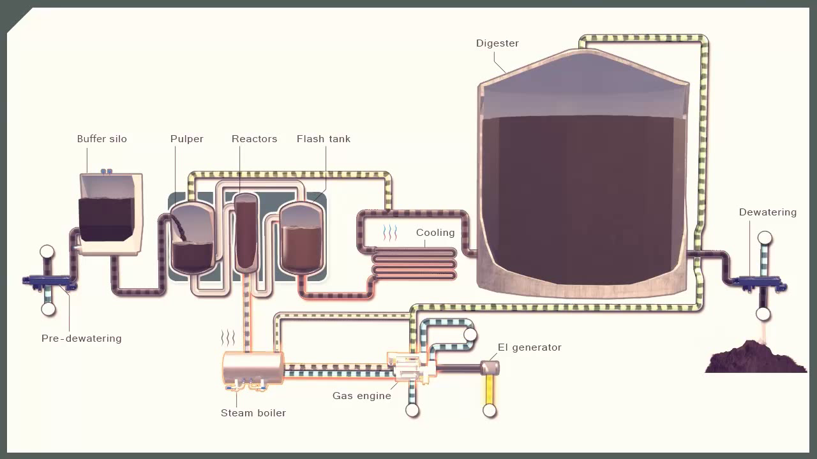
CAMBI THP

Slide 4

Dampeksplosjon gir bedre utråtning

Slide 5
FERDIGSTILT KAPASITET
Notes:
Here’s the slide about Cambi’s own technology (Sludge Thermal Hydrolysis) being tracked down the Adoption Life Cycle line.
There are two pieces of good news in this slide:
Our technology has just “crossed the chasm” into the Early Majority phase; and
Cambi is alone responsible for more than 90% of the cumulative capacity installed. We are the undisputed leader in this segment.

Slide 6
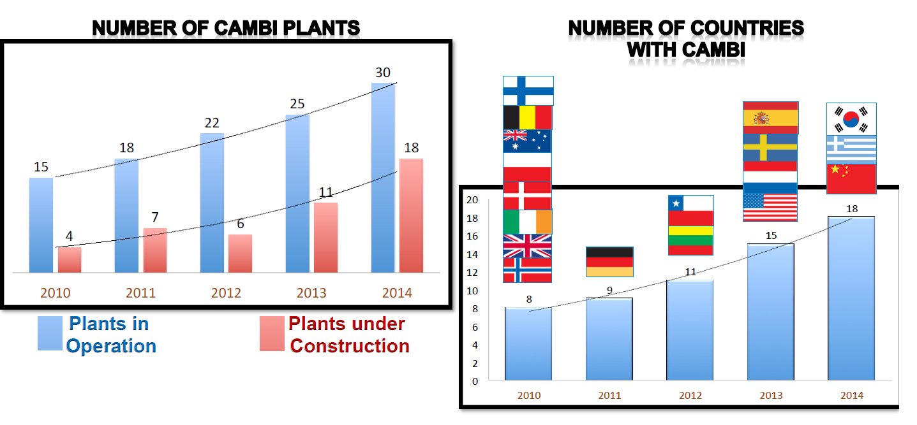

2010 - 2015 Cambi THP akseptert i hele verden
2015
Singapore
19th Country
adopts
Cambi
Notes:
- This illustrates our introduction of new and modern
technology around the world.
- Our technology is operating in 19 countries.
Singapore is the latest.

Slide 7
Markedsandel for Cambi THP
* = operating; **operating & expanded, (*) closed down (pilot/decommissioned), *? Uncertain operating status. All other under design/construction

Slide 8
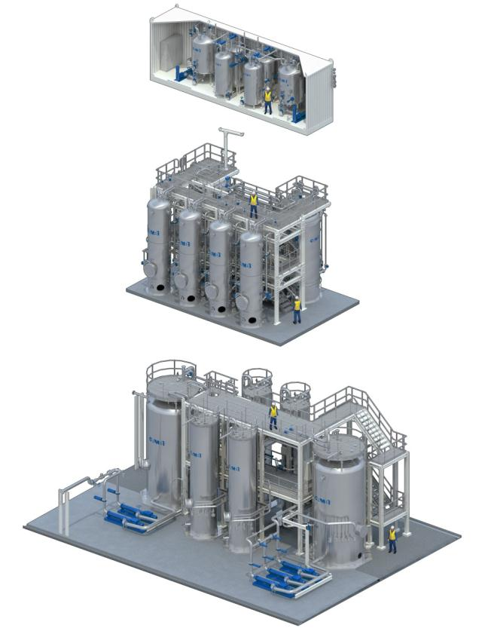
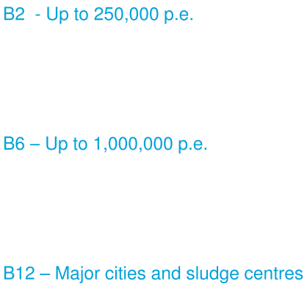
Standard Cambi THP modeller

Slide 9
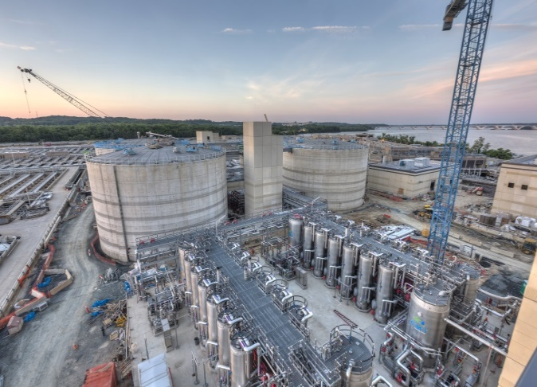
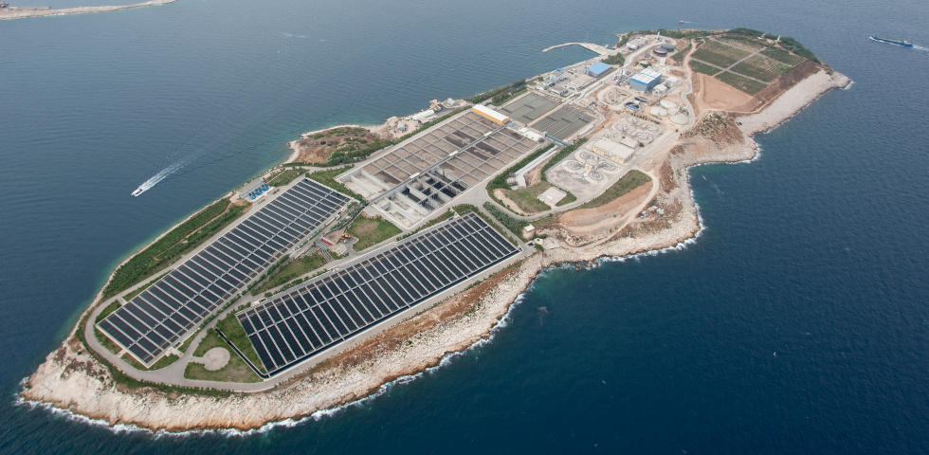

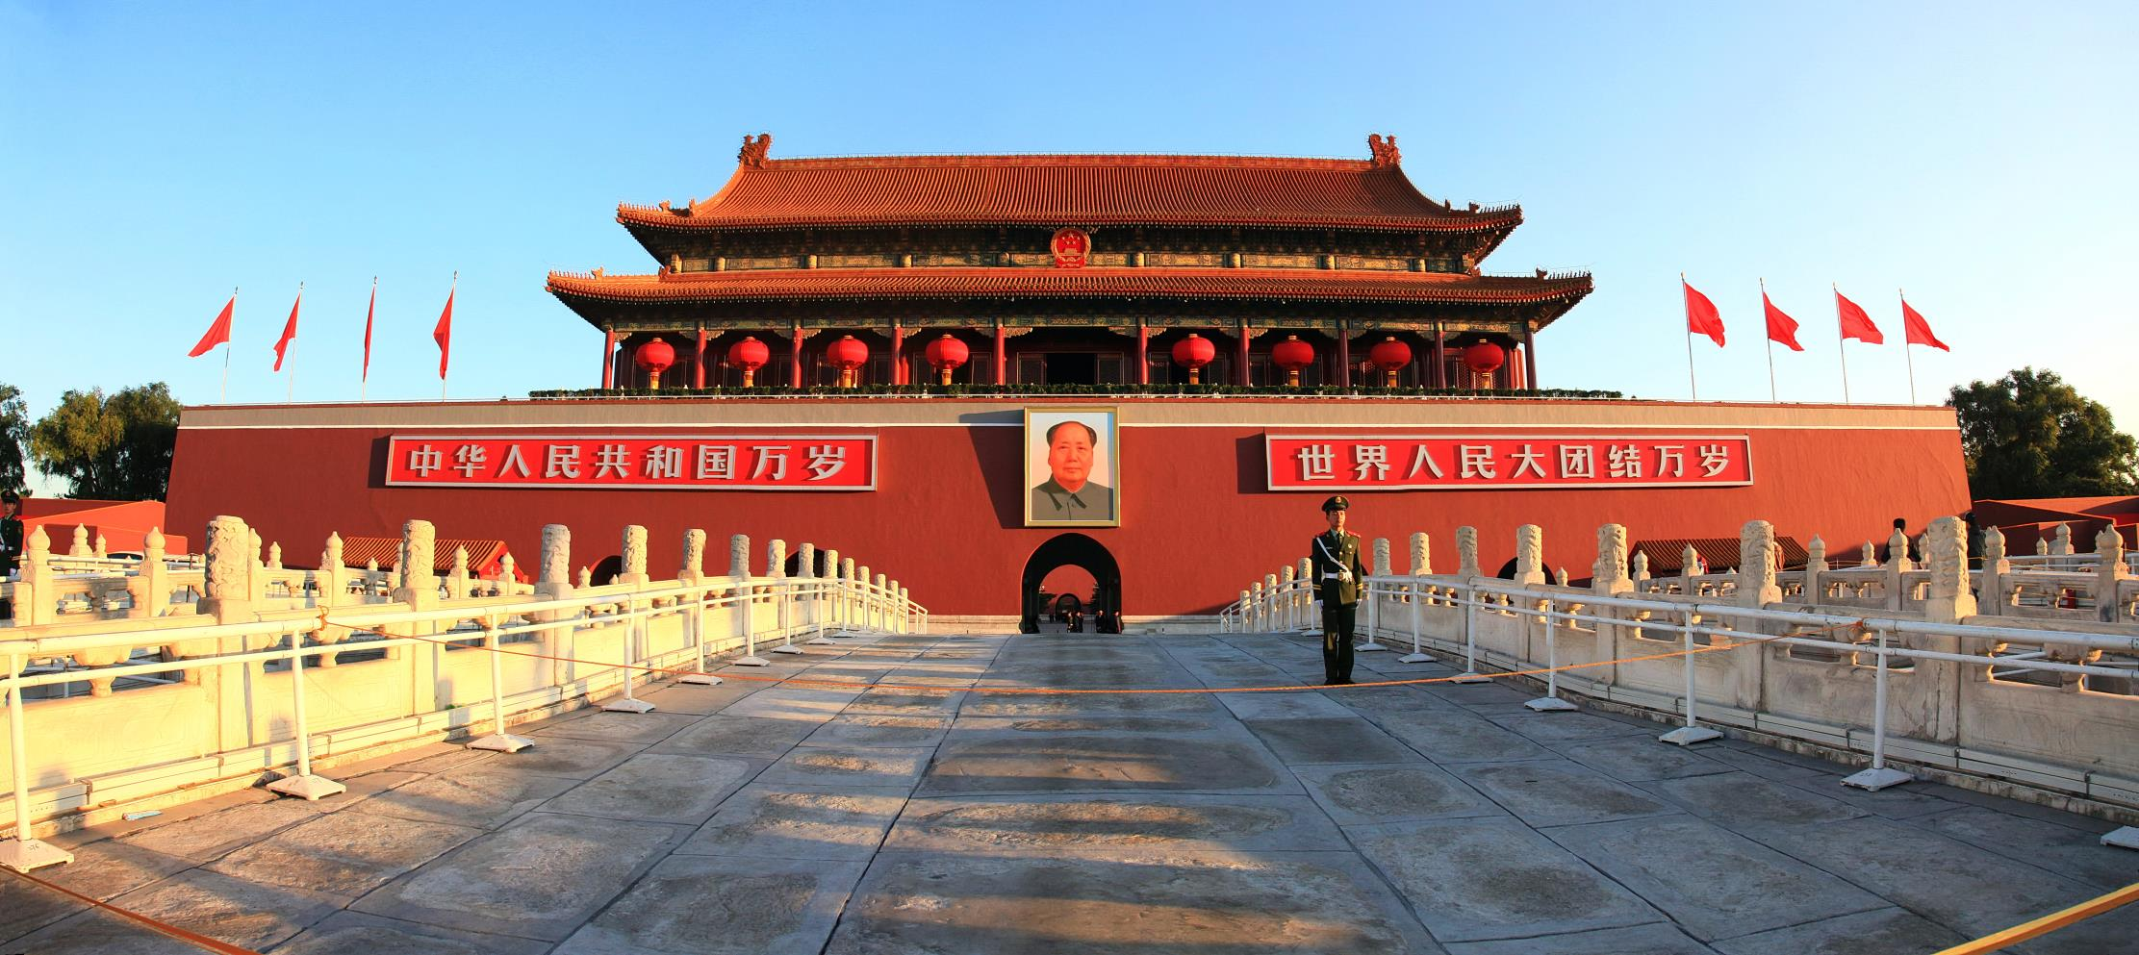
50 CAMBI anlegg betjener 50 millioner mennesker
Washington DC, USA
Athens, Greece
London, England (6 plants)
Beijing, China (5 plants)
Notes:
Independent Norwegian technology & engineering company since 1989
Designs, builds & operates the CAMBI Thermal Hydrolysis Process (THP)
A pre-treatment technology before anaerobic digestion of sewage sludge
Optimizes digestion and dewatering, reduces digester volume, increases gas production
Delivers a high quality (Class A) end product (biosolids) and/or half the cake for drying/incineration (compared to conventional digestion)
51 plants for ± 1,430,000 t dry solids/year, approx. 590,000,000 m³ biogas/year, and 1,400 GWh green electrical power, when using gas engine cogen
Green energy production replaces 1,400,000 tonnes of fossile CO2 emissions.
Typical WWTP size : 200,000 to 10 Million People Equivalent
!Cambi THP is a key technology for any sludge disposal strategy!
!Cambi THP is a key technology for any sludge disposal strategy!

