Slide 1
Research support to the Fagerberg Committee
International comparison of goal-oriented public governance in research policy
Erik Arnold
13 December 2010

Slide 2
Countries, questions
The team has been busying itself with desk research to answer the study questions, for each of our seven countries
  Canada, Denmark, Finland and The Netherlands, New Zealand, Sweden and the UK
The work has been organised around the seven topics listed in the study specification
  Description of research systems and allocation of funding
  Efficiency of the research performing sectors
  Research education
  Research funding mechanisms and criteria
  Monitoring target achievement
  Cataloguing research production
  Successful goal-oriented research policy

Slide 3
Context
Research policymaking at the overall level has three dimensions
  Development of a robust and dynamic research system comprising institutions able to produce knowledge and human capital of high quality and capability
  Identifying and breaking bottlenecks to the functioning of that system
  Enabling change, seizing new opportunities as these appear
Requires
  A policy ‘arena’
  Distributed strategic intelligence
  Prospective study
An explicit strategy is a useful organising device, but few countries have one

Slide 4
The research system - ministries
At the level of government, countries face a choice between centralising research policy in a science ministry or decentralising it to the ministries as representatives of different sectors of society
Among the countries studied, there is movement in both directions, though most favour decentralisation
This creates a coordination problem, since many aspects of research and innovation policy transcend the responsibilities of individual ministries

Slide 5
The research system – research performers
Different countries make different choices about the shape and steering of research performing institutions
Some maintain a strong research institute sector while others such as Denmark have moved away from this and increasingly integrate the institute research functions into the universities
All use ‘binary’ support systems for university research, but the balance between university block grants or ‘institutional funding’ and research council funds varies widely
In most of the countries considered, block grants are bigger than competitive funding – only in the UK is the ratio the other way round

Slide 6
The research system – three advice models
A joint planning model (Japan), where the government uses the Council as a virtual “horizontal ministry of innovation”, much as engineering companies build project teams by bringing together people across different disciplines
A co-ordination model (Chile, Finland, Netherlands Innovation Platform, to some extent Austria), where the intention is that the council should communicate horizontally across ministry responsibilities so as to align policies in support of innovation, without this alignment always being binding
An advice model (Canada, Denmark, Ireland, Netherlands AWT, Sweden, Switzerland, UK), where the government is happy to be proactively or reactively advised on research and innovation policy but does not want to be restricted by that advice

Slide 7
Block grants dominate university funding (except UK)
Index | Uni Block Grants | Research Councils | Institutes/Labs
CA | 1.00 | 0.51 | 0.43
DK | 1.00 | 0.59 | 0.06
FI | 1.00 | 0.70 | 0.54
NL | 1.00 | 0.33 | 0.53
NZ | 1.00 | 0.38 | 0.22
SE | 1.00 | 0.42 | N/A
UK | 1.00 | 1.68 | N/A

Slide 8
Shifting from GOVERD to HERD (as % of GDP)

Slide 9
Research Council budgets are up but basic research is in relative decline (except UK)
Country / Segment | Year | Basic Research | Applied Research | Experimental development
DK Higher Education | 1999 | 63% | 28% | 9%
 | 2006* | 55% | 33% | 12%
DK Government | 1999 | 30% | 51% | 19%
 | 2006* | 15% | 63% | 22%
NZ Higher Education | 1999 | 68% | 32% | 0%
 | 2007 | 53% | 28% | 18%
NZ Government | 1999 | 53% | 36% | 11%
 | 2007 | 40% | 43% | 17%
NO Higher Education | 2005 | 49% | 36% | 15%
NO Government | 2005 | 17% | 61% | 22%
UK Government | 2002 | 30% | 54% | 16%
 | 2006 | 32% | 53% | 15%

Slide 10
Research efficiency – universities and research funders
We can find no systematic evidence that universities are becoming more administration-intensive
This issue would require original research to explore further
Research funders’ administrative costs appear to be flat or slightly declining, based on the numbers we have been able to collect

Slide 11
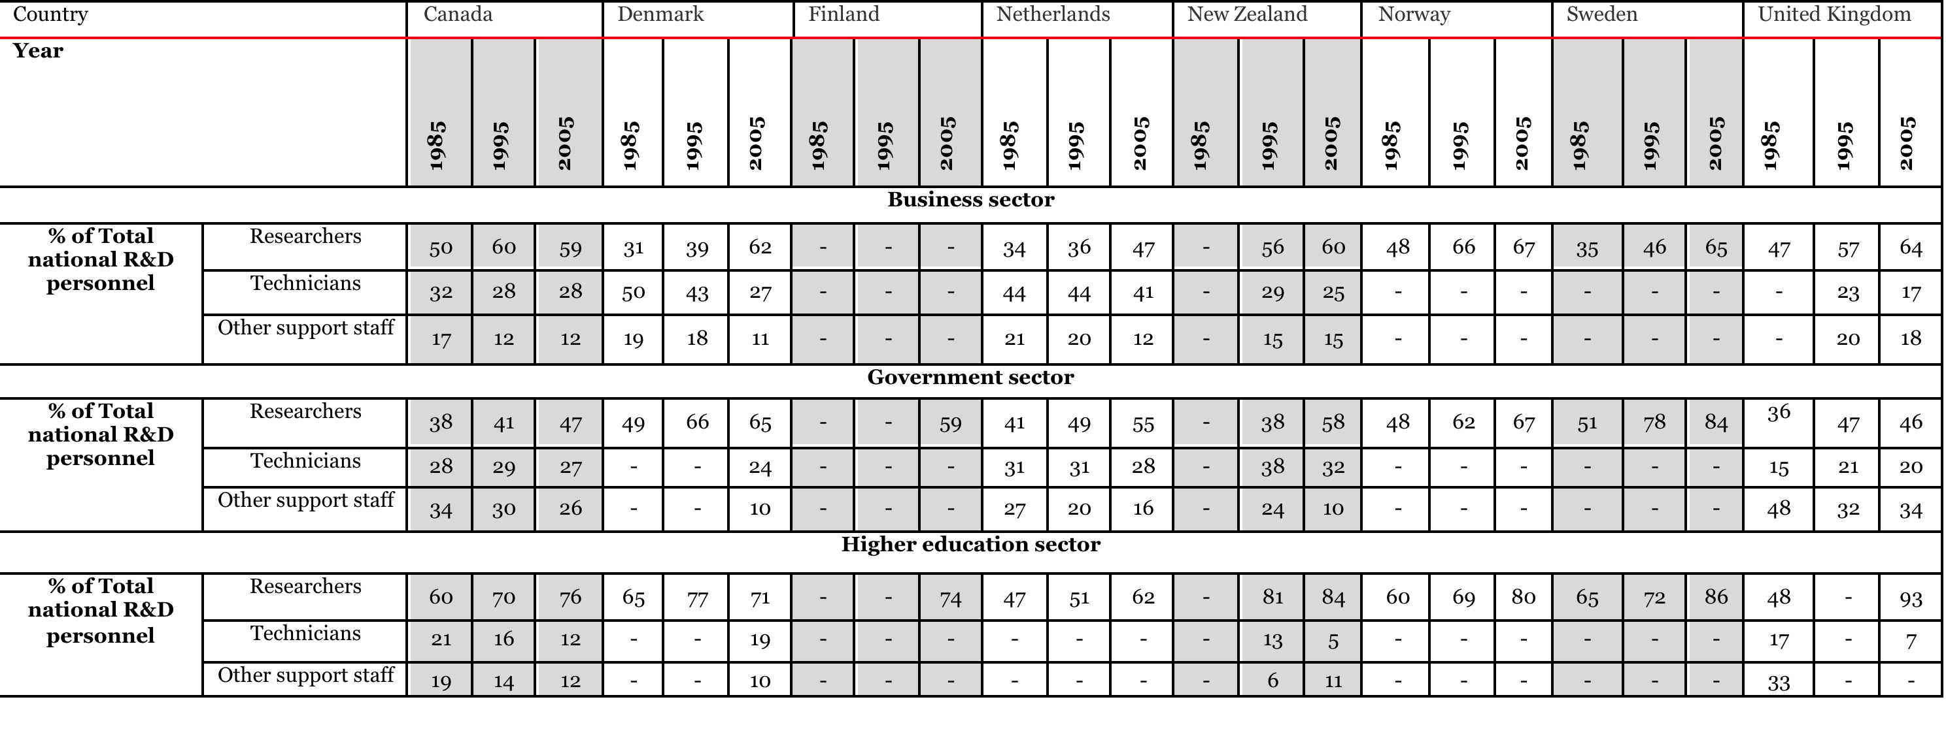
Research efficiency – manpower

Slide 12
A range of funding instruments for doctoral training, increasingly dominated by graduate schools
Funding Mode | CA | DK | FI | NL | NZ | SE | UK
As part of a project grant from an external funder, eg Research Council |  |  | X |  | X | X | X
Funded from the university block grant | X | X | X | X | X | X
Stipends competitively allocated by external funders to university departments | X | X | X | X |  | X | X
Personal stipend | X |  | X | X |  |  | X
Dual PhD training |  | X |  | X |  | X | X

Slide 13
Admission criteria for doctoral training
Criteria:
  Block grant to institutions – various combinations of capacity & quality measures (typically based on the same method used to allocate block research grants – e.g. NZ bases doctoral allocation on same quality measure (PBRF) as block research grants)
  Competitive doctoral programmes
    UK: based on competitive grant income from each research council
    Finland: open competition – review and selection by funding agency
  Doctoral applicant quality – undergraduate relevance and performance, academic/ employer references, interview – fairly standard approach across all countries

Slide 14
Research funding overview
Objective:
Quality and Impact of (publicly funded) Research
Government R&D expenditure
Funding source:
Over-arching allocation method:
Institutional core funding
Project funding
Capacity/ volume
and/or
Quality
e.g. quality of past research
Quality
e.g. quality of individual proposed research projects
Impact
e.g. potential impact of proposed research projects
Criteria:
Assessment method:
Objective indicators
e.g. no. of research staff
Objective indicators
e.g. no. of outputs bibliometrics
Qualitative indicators e.g. Peer review
Qualitative indicators –
Peer review
Qualitative indicators –
Peer review

Slide 15
Performance Based Research Funding (PBRF)
The sampled countries follow the international trend towards PBRF mechanisms
Countries polarise between those that reallocate small (almost symbolic) amounts of money and those that drive the majority of institutional funding on the basis of performance
There is a trend towards greater use of performance indicators – especially publication – and increasingly mechanistic ways of reallocating money
Given the dangers inherent in such systems, they tend to apply in the cases where only small amounts of funding can be reallocated
There is so far little evidence that PBRFs work, but some evidence that they can have perverse effects (eg Australia)

Slide 16
PBRFs – Advantages and Drawbacks (Geuna & Martin)
Advantages | Drawbacks
Performance-based – ‘meritocratic’ in that it links resources to performance, rewarding good research Strong incentive to improve individual as well as institutional performance Competition may lead to increased efficiency – ineffective research identified and cut Encourages research to be properly completed and written up for wider dissemination Provides public accountability for government funds invested in research Encourages more explicit/coherent research strategy on part of department or institution Provides mechanism for linking university research to government policy (e.g., to shift priorities) Concentration of resources may enable best departments to compete with world leaders (e.g., in US) | High cost and labour intensity (whether peer review or indicator-based) for universities and evaluating agencies May cause ‘homogenization’ of research and universities – i.e., decrease in diversity and experimentation May discourage more innovative and risky research Encourages ‘publication inflation’ (e.g., ‘salami publishing’) and other ‘game playing’ (e.g., with indicators) – i.e., ‘looking good’ rather than necessarily doing better May encourage traditional ‘academic’ research at expense of research linked to society’s needs Tends to separate research from teaching, implying lower priority for teaching Rewards past performance not current or future potential Reinforces research elite/status quo – may cause overconcentration May lead to excessive government influence/‘interference’ in university

Slide 17
Lessons from wider international experience with PBRFs
Move slowly enough to let the system respond to the changed incentives
Take small steps – moving small amounts of money has big effects on behaviour
Explicitly tackle field differences
Do not use solely indicator-based approaches but combine these with other allocation principles
Pilot the system before using it

Slide 18
Monitoring target achievement
Performance contracts are increasingly used in steering agencies and research performing institutions
Performance indicators used do not conform to a single standard but tend to be developed ad hoc for each contract
A surprising proportion of such indicators relate to processes rather than outcomes and impacts, which is perhaps an important reminder of just how hard it is to develop meaningful indicator systems for the latter
At a lower level, project performance is increasingly being monitored, providing agencies with opportunities better to understand the activities of their beneficiaries and to consider the degree to which progress is being made towards programmatic and institutional goals

Slide 19
Cataloguing research outputs
A key problem for the assessment component of PBRF systems is language, since the bibliometric indexes have a bias towards English
Such systems need also to handle the fact that many scholars, especially outside the ‘hard’ sciences, use channels such as books and monographs that are invisible to journal-based bibliometrics
Some countries have begun to catalogue national research outputs, in support of a PBRF system. Without a PBRF, there seems little point in doing do
This seems to be necessary where research is published in small languages and in order to take proper account of the social sciences and humanities in mechanical systems

Slide 20
Goal-oriented public policy
Growing use of targeting and performance contracting, driven by the New Public Management
Careful analysis of intervention logics is needed, preferably using logic charts
Design dilemma: counting things that don’t matter versus counting things that matter but can only be influenced
Use of multi-layered performance goals is rare (NZ) but may be useful in combination with an explicit strategy (Chile
Goal orientation does not replace the need for coordination and decentralised intelligence

Slide 21
Thank you
technopolis |group| has offices in Amsterdam, Ankara, Brighton, Brussels, Frankfurt/Main, Paris, Stockholm, Tallinn and Vienna

