Slide 1
Den nye EITI-standarden
og konsekvenser for norsk rapportering
Anders Kråkenes,
Communications Manager at
the EITI International Secretariat

Slide 2
Agenda
Hva er nytt i 2013 EITI-standarden?
Hva er konsekvensene for Norge?
Kort orientering fra EITI internasjonalt.

Slide 3
Utviklingen av EITI
2003 | EITI Principles
2005 | EITI Criteria and Sourcebook (non binding guidance)
2008 | EITI Validation Guide (binding requirements)
2011 | EITI Rules and Validation Guide
2013 | EITI Standard

Slide 4
EITI-standarden
Konsultasjoner over 3 år
Basert på erfaringer og god praksis
Mål: et mer effektivt og relevant EITI
Notes:
Puts national objectives and reform agendas front and centre
Emphasis on objectives and work plans for EITI implementation
Widening EITI reporting, including presenting the context
Strengthening EITI reporting
Impact and Validation
Restructuring and clarifying the requirements

Slide 5
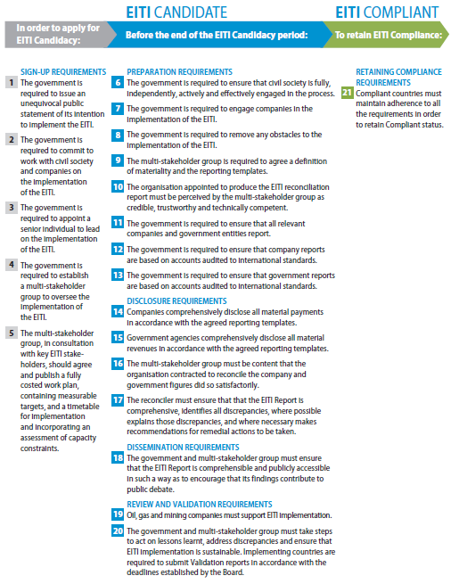
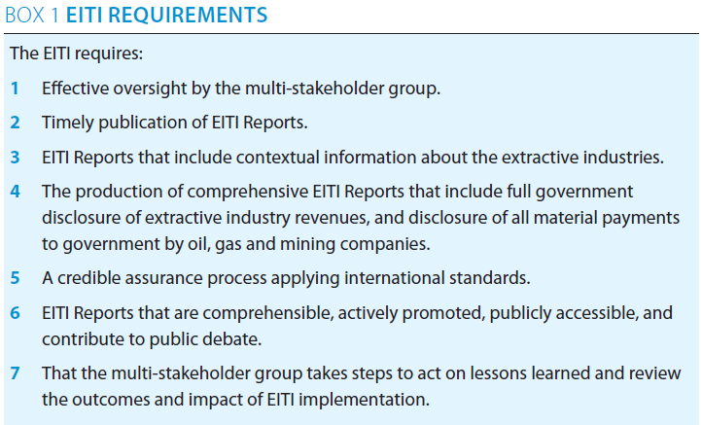
EITI Rules (2011)
21 Requirements
EITI Standard (2013)
7 Requirements

Slide 6
What is the EITI?
Ensuring more transparency and accountability in the natural resource value chain.
Licenses & contracts
Monitoring production
Tax collection
Revenue distribution
Expenditure management
Licensing information
Transfers to local government
Company social and infrastructure investments
Production data
State
ownership
Companies publish payments
Government publish receipts
Contract
transparency
(encouraged)
Transit
payments
(encouraged)
State
Owned Enterprises
Beneficial
ownership
(encouraged)
A national Multi-Stakeholder Group (government, industry & civil society) decides how their EITI process should work and oversees it.
This group publishes an EITI Report where government revenues and other data are disclosed and independently verified.
The findings are communicated to create public awareness and debate about how the country should manage and use their resources better.

Slide 7
2. Hva er konsekvensene for Norge?
Diskusjon
Hva vil gjøre EITI mer relevant? (timing, forenkling, samkjøring, kommunikasjon)
Hvilke mål kan settes i arbeidsplanen for 2014 og 2015?

Slide 8
Behov for avklaringer, deriblant i forhold til følgende punkter i EITI-standarden:
Hvordan møte punktene om kontekstuell informasjon, kobling til “Oil Facts”, etc. (3)
rapportering av dividende fra statoil (4.1.b.v)
rapportering av salg (4.1.c)
publisere elektroniske filer - minumum: excel, slik som har vært gjort tidligere (6.2)
avholde lanserings-seminar (6.1)

Slide 9
Standard Terms of Reference and procedures for producing EITI reports

Slide 10
Next steps
Workplan: agreeing objectives, revising the workplan
EITI Report: scoping, contextual information, ToRs for independent administrator, communicate findings.
Annual activity reports: document progress and impact.

Slide 11
Reminder on deadlines
Norway is:
Expected to update the workplan by 31 Dec 2013.
Required to produce the 2012 EITI Report in accordance with the EITI Rules by 31 Dec 2014, then the 2013 report in accordance with the EITI Standard by 31 Dec 2015.
Required to publish the 2013 Annual Report by 1 July 2014.
Required to commence Validation by 1 Jan 2016.

Slide 12
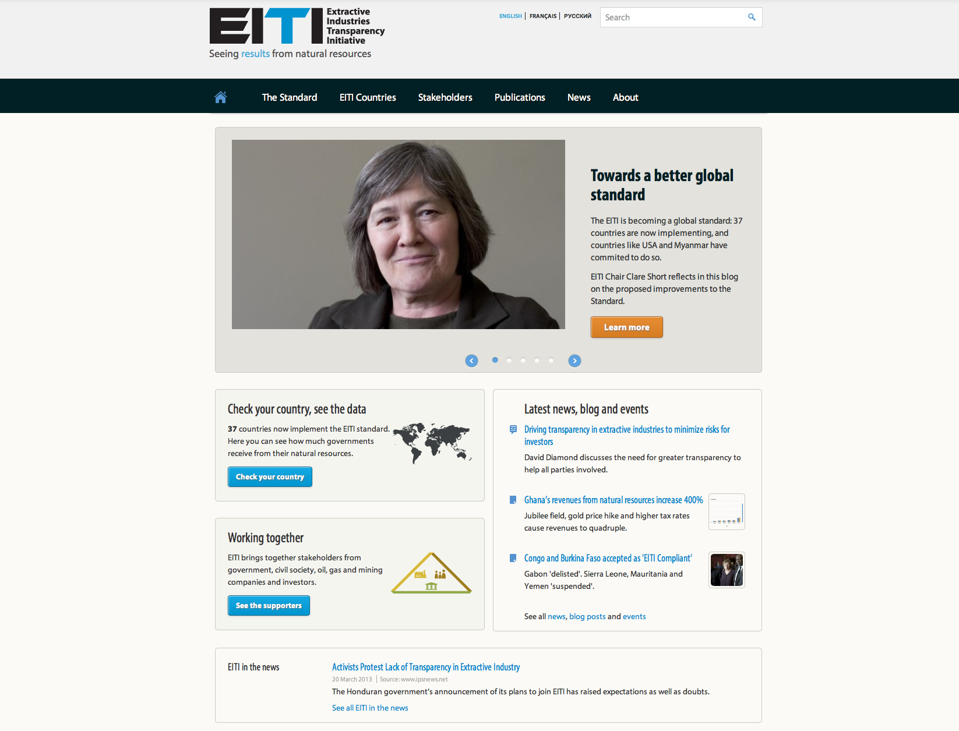
Thank you!
akrakenes@eiti.org
www.eiti.org
Notes:
Do stay in touch!

